Slide 1



高质量合成数据与应用供应商
AI-Based Synthetic Data/Application Vendor
ML5G-PS-009:
Synthetic Observability Data Generation using GANs
Beijing Quant Evolution Inc.（北京宽客进化科技有限公司）
China Mobile Research Institute（中国移动研究院）
2022.12.1

Slide 2
Problem statement
1
2
Cloud workload data：
Limited workload data
Memory:
memory_free
memory_used
CPU:
cpu_user
cpu_system
cpu-idle
Load:
Shortterm
Midterm
Longterm
Network:
if_octets_rx
if_octets_tx
if_packets_rx
if_packets_tx
if_errors_rx
if_errors_tx
if_dropped_rx
if_dropped_tx
3
Generate synthetic workload
data

Slide 3
Solution overview
Data processing
Data generation
Assessment
Data fact
Data cleansing
Training tabular WGAN-GP
Generate load、cpu、disk、memory
Reorder the time series
Generate network
Evaluate synthetic data

Slide 4
Data processing
Data facts
Data cleansing
A. Non-uniform sampling time
1. sampling data with 1 sec
2. Remove the value ‘NAN’
B. number of features is various
3. Sum up the corresponding CPU, interface data in one node;
C. Non-stationary time series
4. GAN models are individually trained
D. ‘load’ is the causal factor
5. The GAN is conditioned by the tendency of the load.

Slide 5

GAN Framework
WGAN-GP
Wasserstein GAN + Gradient Penalty, or WGAN-GP, is a generative adversarial network that uses the Wasserstein loss formulation plus a gradient norm penalty to achieve Lipschitz continuity.

Slide 6
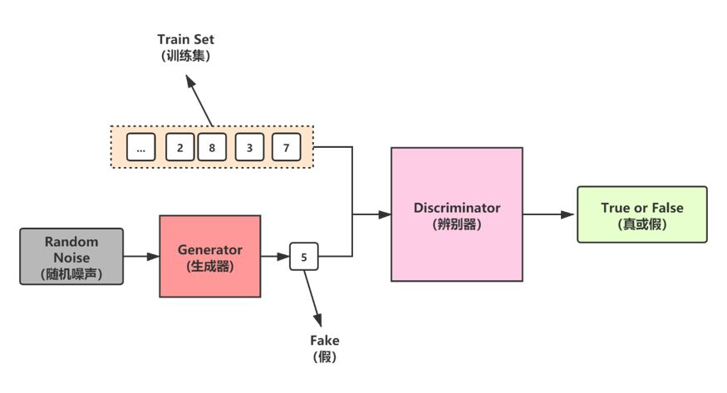
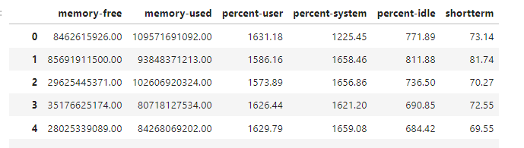
Data generation
Train GAN
Generated workload data

Slide 7
Training the model

Slide 8
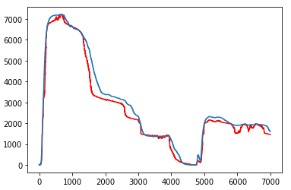
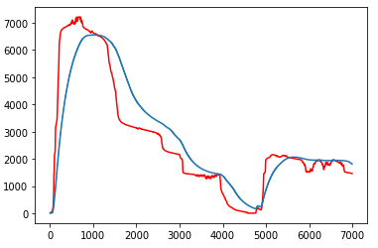
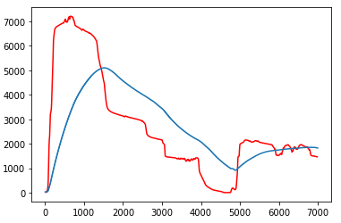
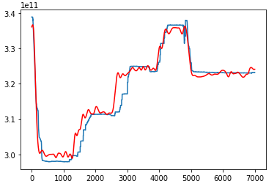
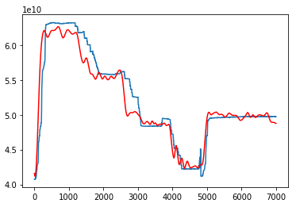
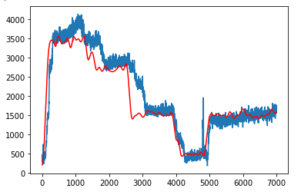
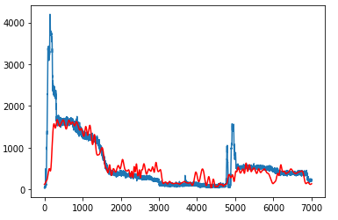
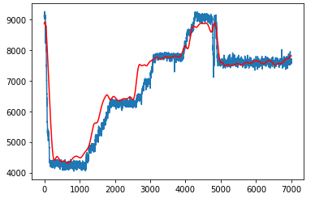
Reorder time series
Shortterm
Midterm
Longterm
Memory free
Memory used
CPU user
CPUsystem
CPU idle

Slide 9
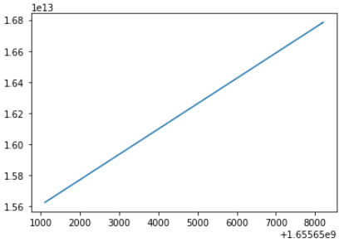
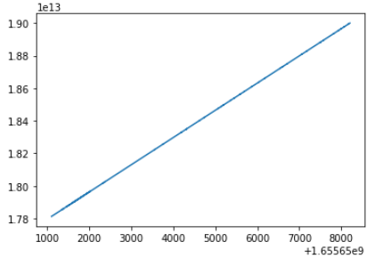
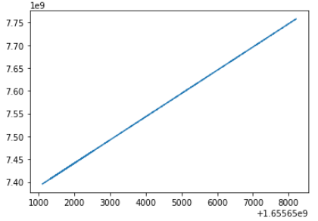
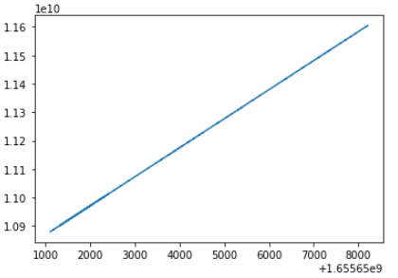
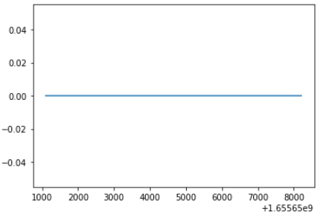
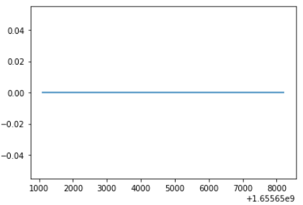
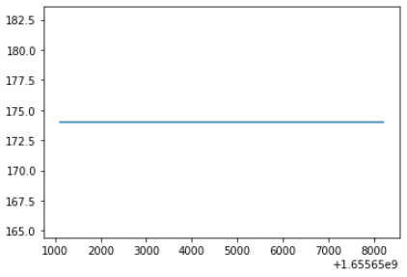
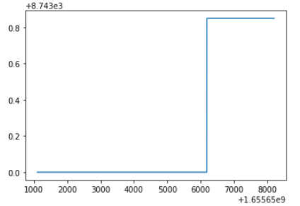
Network generation
Generate network data
If octets rx
If octets tx
If packets rx
If packets tx
If errors rx
If errors tx
If dropped tx
If dropped rx

Slide 10
Assessment
 | Memory free | Memory used | CPU user | CPU system | CPU idle | Shortterm | Midterm | Longterm
Wasserstein distance (synthetic data) | 0.0420 | 0.0489 | 0.0702 | 0.1847 | 0.0657 | 0.0540 | 0.1039 | 0.2483
Wasserstein distance (real data) | 0.0076 | 0.0123 | 0.0254 | 0.0208 | 0.0149 | 0.0140 | 0.0146 | 0.0271
Wasserstein distance (random data) | 0.2558 | 0.2510 | 0.1948 | 0.4511 | 0.2880 | 0.3421 | 0.3248 | 0.2273

Slide 11
Assessment
 | Memory free | Memory used | CPU user | CPU system | CPU idle | Shortterm | Midterm | Longterm
Autocorrelation (synthetic_data) | 0.9509 | 0.9427 | 0.9462 | 0.9240 | 0.9571 | 0.9662 | 0.9661 | 0.9662
Autocorrelation (real_data) | 0.9541 | 0.9607 | 0.9221 | 0.8601 | 0.9498 | 0.9712 | 0.9811 | 0.9833

Slide 12
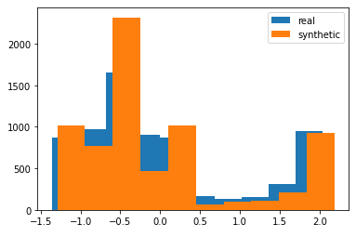
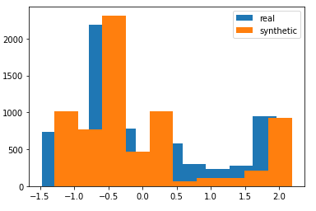
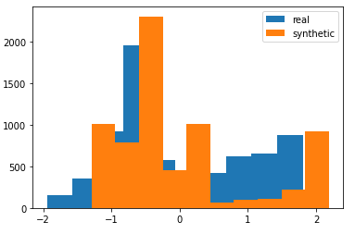
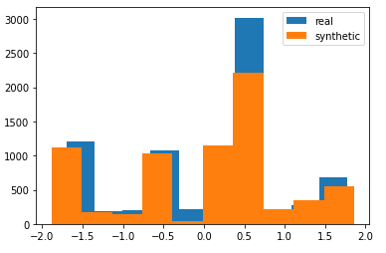
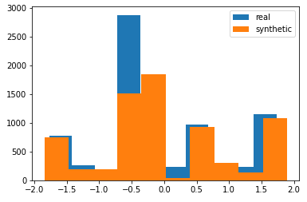
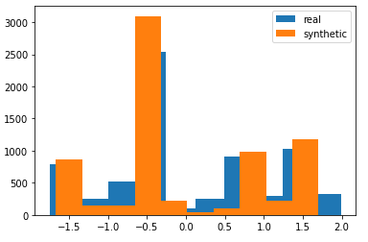
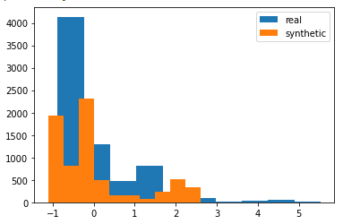
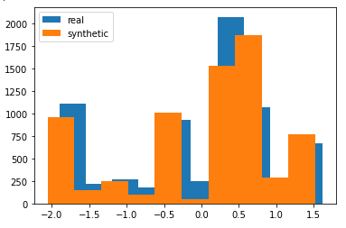
Assessment
各特征分布
Shortterm
Midterm
Longterm
Memory free
Memory used
CPU user
CPU system
CPU idle

Slide 13
Generate workload data by conditions

Slide 14
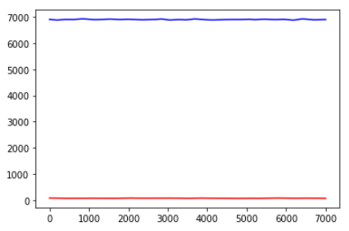
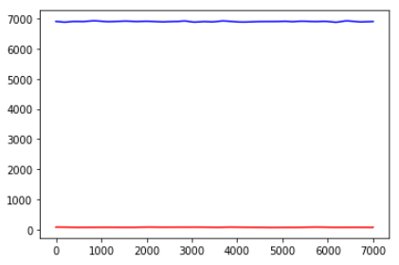
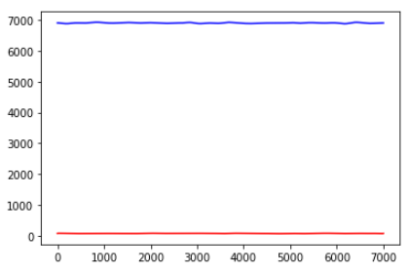
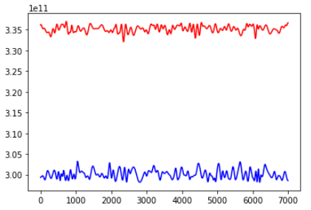
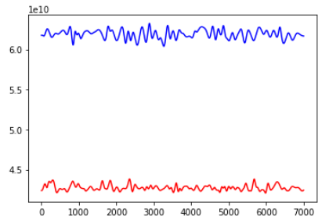
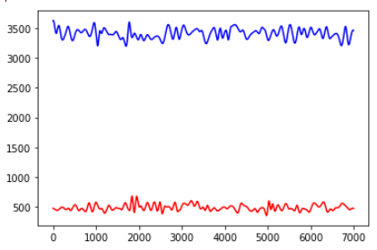
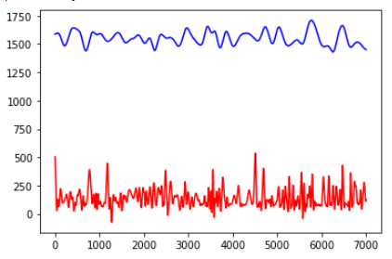
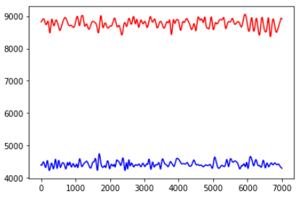
High/Low workload generation
High workload
Low workload
Shortterm
Midterm
Longterm
Memory free
Memory used
CPU user
CPU system
CPU idle

Slide 15
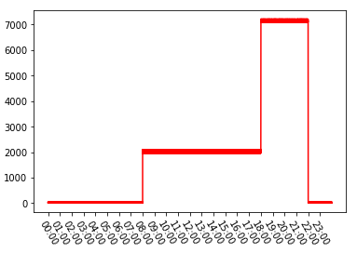
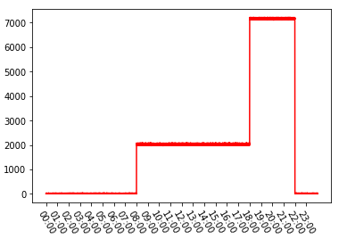
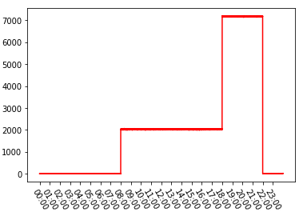
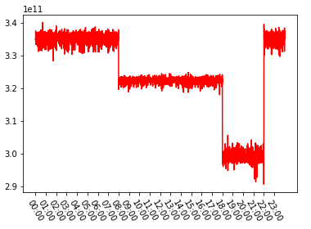
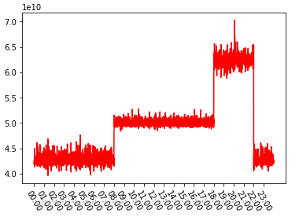
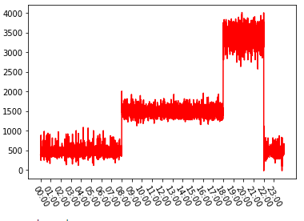
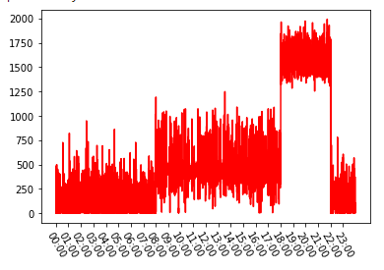
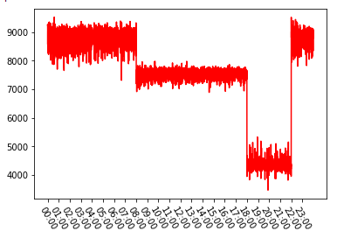
Daily workload generation
Daily workload
Shortterm
Midterm
Longterm
Memory free
Memory used
CPU user
CPU system
CPU idle

Slide 16
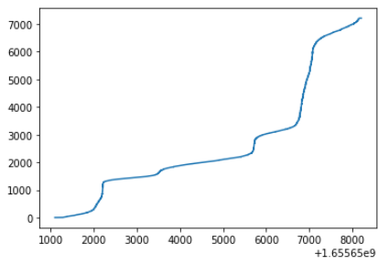
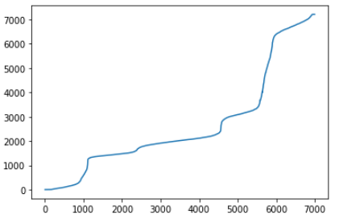
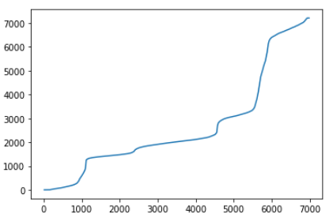
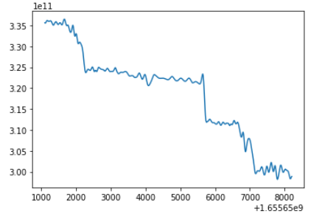
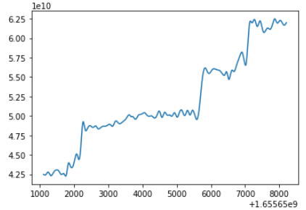
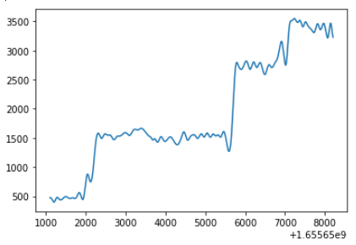
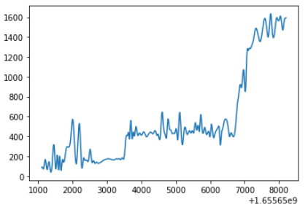
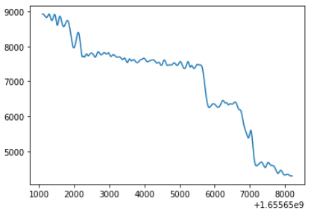
Complex workload generation
Workload climbs up
Shortterm
Midterm
Longterm
Memory free
Memory used
CPU user
CPU system
CPU idle

Slide 17

感谢指导
ai-quants.cn
deepgi.cn

Slide 18


